Slide 1


Chaos Monkey Experiments: Strengthening Banking Systems
Welcome to SIDGS Global Solutions' demonstration on Chaos Engineering for robust banking systems. We'll explore how controlled failures can uncover vulnerabilities and enhance system resilience.

Slide 2
Understanding Chaos Engineering
SIDGS Methodology to Chaos Engineering
SIDGS Approach to Chaos Engineering
Key Pillars of Chaos Engineering
Why Banks Need Chaos Engineering
Chaos Engineering Phases
Common Use Cases Of Chaos Engineering
Fund Transfer End-to-End Flow
End-to-End Workflow Chaos Engineering
Appendix
Agenda

Slide 3


Unleashing Resilience: The Principles of Chaos Engineering
Chaos Engineering intentionally injects controlled failures into software systems. This proactive approach uncovers weaknesses and enhances overall system reliability. It simulates real-world failures like network outages, server crashes, and traffic spikes in a safe environment.​
The primary goal is to observe system responses, identify failure points, and understand behavior under stress. By revealing vulnerabilities, engineers can redesign architecture
and implement targeted improvements.​
Controlled disruption: Simulating various failures​
Scientific approach: Formulating and testing hypotheses​
Monitoring: Measuring system behavior​

Slide 4

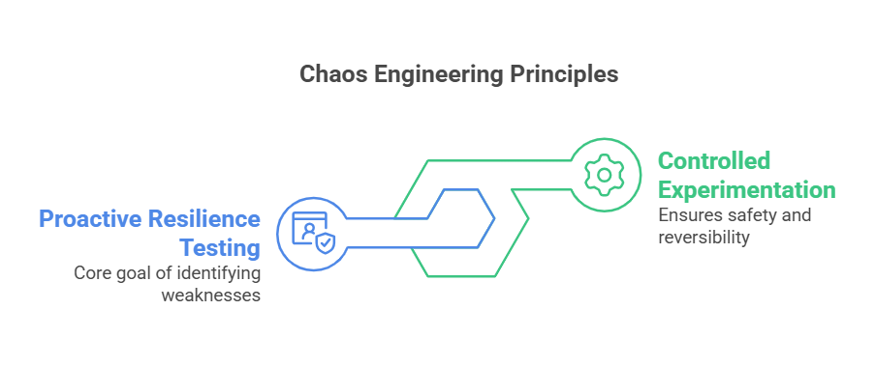
Proactive Resilience Testing
Controlled Experimentation
Chaos Engineering simulates real-world disruptions to identify system weaknesses before they become critical.
All chaos experiments are carefully planned, monitored, and safely rolled back if needed.

Slide 5

Key Segments of Chaos Engineering
Infrastructure Disruptions
Performance Stressors
Simulate micro component failures, VM shutdowns, and data center disconnections to test system resilience.
Inject latency, simulate high CPU/memory loads, and cause traffic spikes to evaluate system stability.
Software-Level Chaos
Complex Scenarios
Introduce function exceptions, code insertions, and clock syncing issues to uncover hidden vulnerabilities.
Emulate I/O errors and inject intricate failures to prepare for real-world contingencies.

Slide 6

Elevating Bank Resilience with Chaos Engineering
Core Benefits
Improved System Resilience
Minimized Downtime
Enhanced Security
Faster Incident Detection
Better Customer Experience
Financial Advantages
Cost-Effective Risk Management
Improved Disaster Recovery
Regulatory Compliance
Innovation

Slide 7
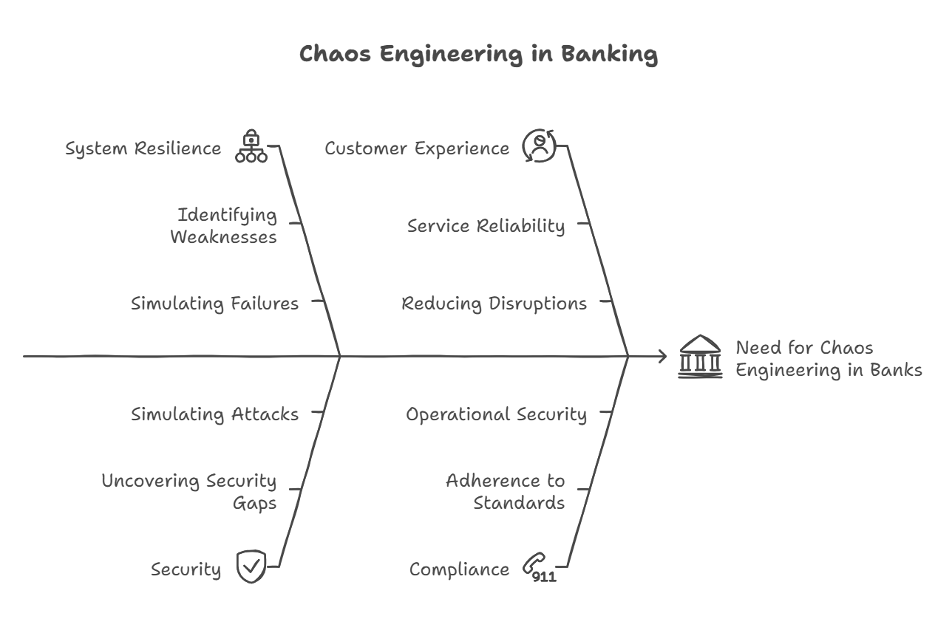

Slide 8





SIDGS Approach
Blast Radius: Testing System Resilience
Identify
Controlled & Gradual Experimentation
Pinpoint crucial systems. Begin testing in non-production setups.
Continuous Learning & Iteration
Realistic & Business-Critical Failure Scenarios
Hypothesize
Predict outcomes. For example, reroute database on node failure.
Run Experiment
Security & Compliance Integration
Automated & Continuous Chaos Testing
Execute gradually. Start small. Incrementally broaden scope.
Monitor
Measure impact. Use tools like Grafana or Prometheus.
Built-in Failover, Recovery & Self-Healing
Robust Monitoring & Observability
Analyze
Improve resilience. Conduct postmortems. Apply fixes.

Slide 9
Cultivating Resilience via
People, Process and Tech
Process
Experimentation Tools
Gremlin: API-level fault injection.
LitmusChaos: Kubernetes-native container failure tests.
AWS FIS: Cloud-native chaos via templates.
Automation in CI/CD
Gremlin APIs/LitmusChaos GitHub Actions.
Terraform Modules for automated chaos.
Observability & Monitoring
Grafana: Visualize system health.
Prometheus & ELK: SLA compliance.
AWS X-Ray: Distributed tracing.
Chaos Engineering Mindset
Failures are learning opportunities.
Resilience is built through controlled experimentation.
Teams grow by anticipating and addressing weaknesses
Benefits of Embracing Failure
Proactive Resilience-
Learn system weaknesses before real incidents occur.
Innovation Culture -
Encourage continuous improvement & experimentation.
Team Empowerment -
Foster collaboration across development, Ops, and QA
Best Practices
Start small. Limit initial experiments to non-production. Automate testing in CI/CD pipelines. Use blameless postmortems to foster learning.
Structured Process
Define hypothesis. Align scenarios with SLAs. Gradual execution, expand to multi-region chaos. Measure and improve with Grafana.
Governance Framework
Set objectives. Define resilience metrics like uptime. Establish team ownership for experiments. Document learnings in evolving playbook.
People
Call to Action
Start Small
Begin with small, controlled chaos experiments.
Psychological Safety
Emphasize safety for teams to explore and innovate.
Key Takeaways
Embrace Failure
See failures as learning opportunities, not setbacks.
Build Resilience
Use controlled experiments to strengthen systems.
Empower Teams
Foster collaboration and innovation through safety.
Tech & Tools

Slide 10
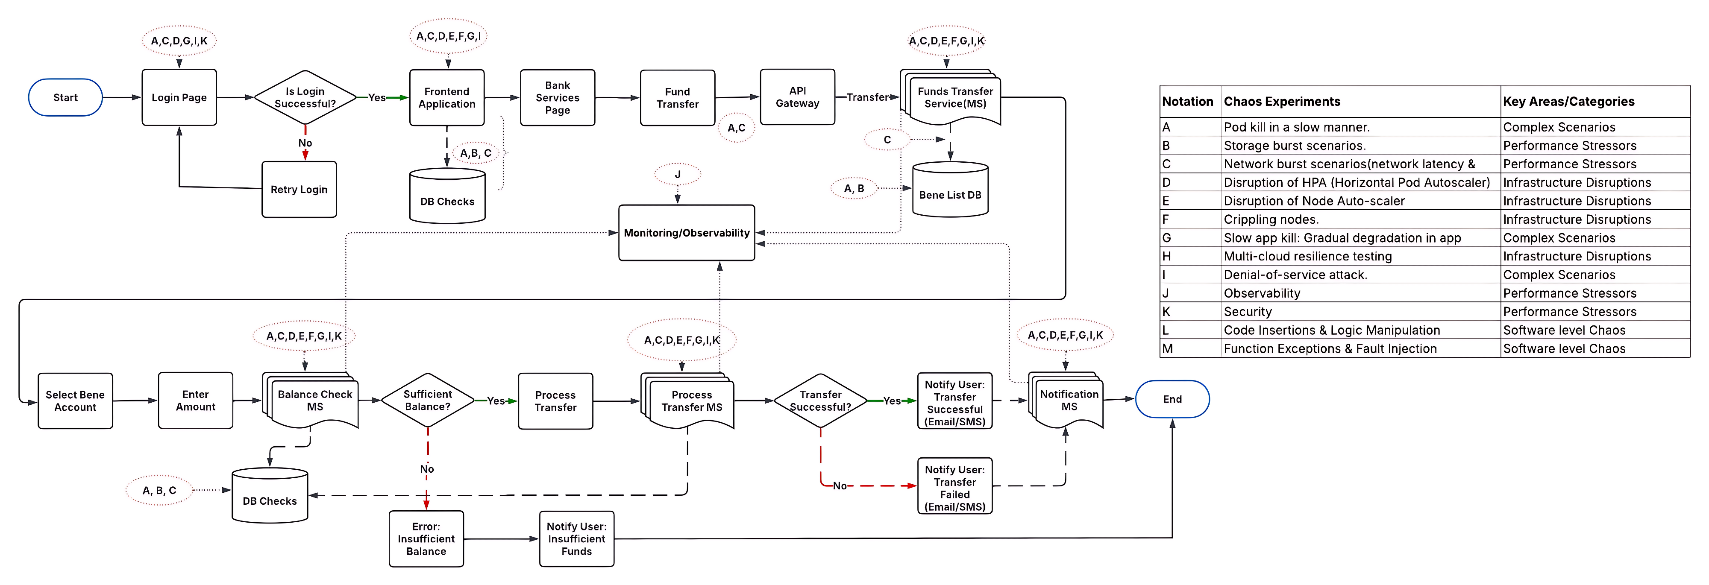
Areas to incorporate Chaos – Fund Transfer Flow

Slide 11
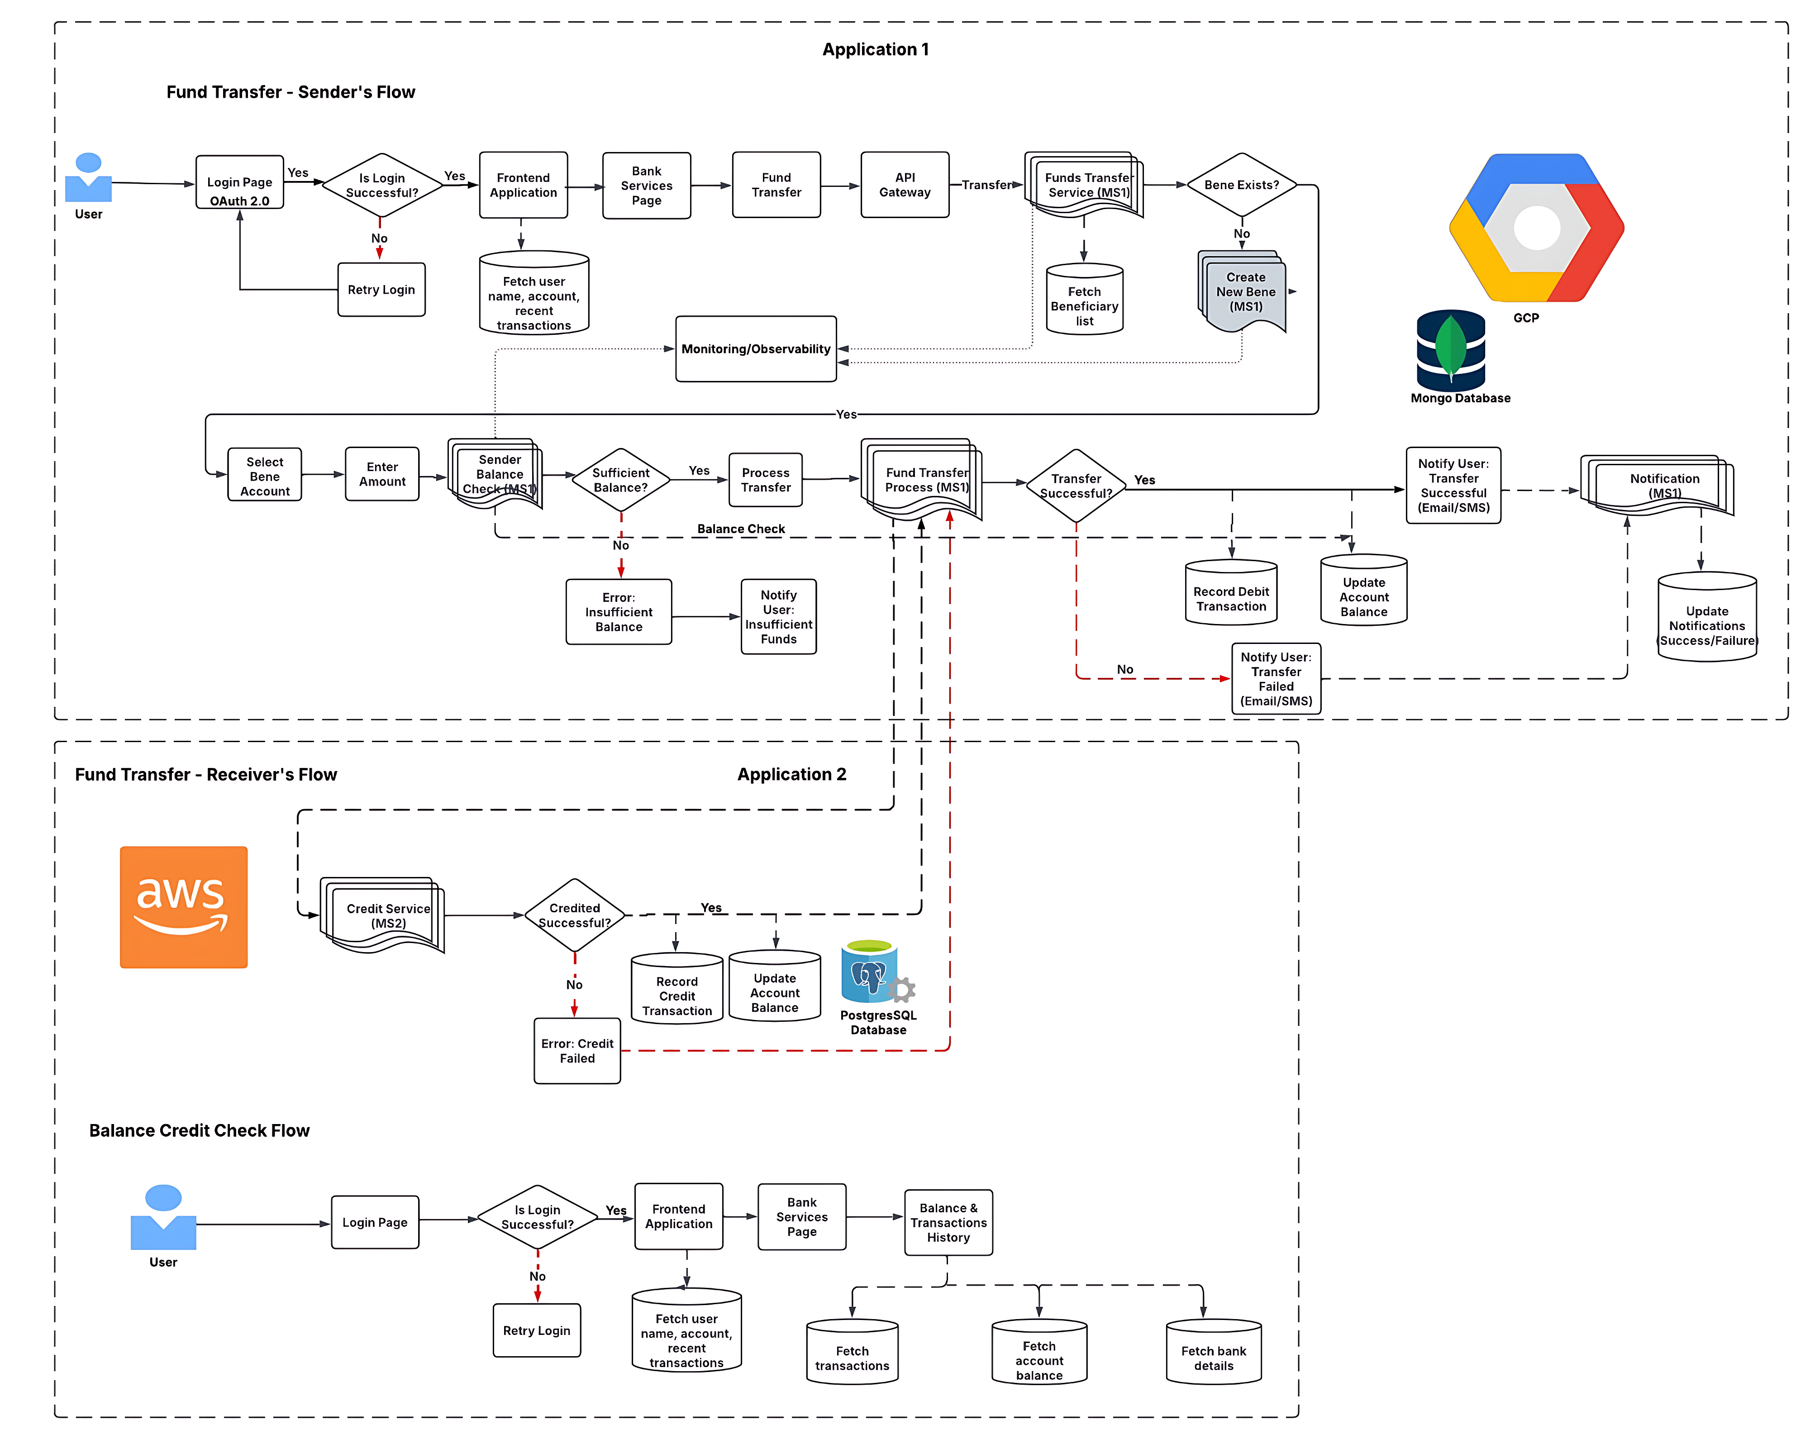
Fund Transfer (End-to-End) Flow:

Slide 12
Any Queries ?

Slide 13
Appendix

Slide 14
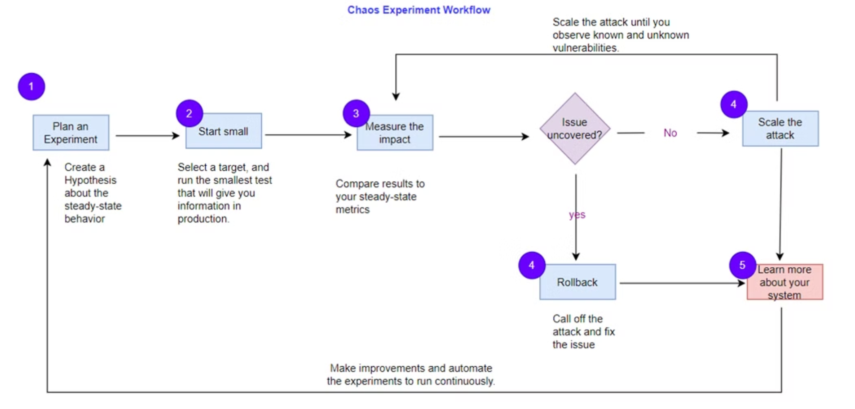
End-to-End Chaos Workflow

Slide 15
Chaos Engineering: Best Practices
Plan & Prioritize
Start Small
Realistic Scenarios
Define clear objectives. Formulate testable hypotheses. Prioritize critical services.
Begin with low-risk experiments. Gradually increase complexity and scope.
Simulate real-world failures. Include network issues and resource exhaustion.
Controlled Experiments
Monitor System Behavior
Automate Testing
Use feature flags to toggle tests. Ensure automatic rollbacks.
Implement observability. Analyze responses using metrics, traces, and logs.
Integrate into CI/CD. Run failure injection in pre-production.
Failover Mechanisms
Continuous Learning
Security & Compliance
Ensure auto-scaling and load balancing. Use circuit breakers and retries.
Document findings and refine architectures. Conduct regular game days.
Limit tests to authorized environments. Encrypt data and avoid SLA violations.
Note : Involve the entire team. Foster a blameless culture. Train on incident response.

Slide 16



Why Banks Need Chaos Engineering
Customer Trust
1
Prevents downtime that erodes confidence in digital banking platforms.
Real-Time Insights
2
Protects critical systems like Kafka pipelines handling millions of transactions.
High Availability
3
Ensures 24/7 availability for essential services like payment processing.

Slide 17
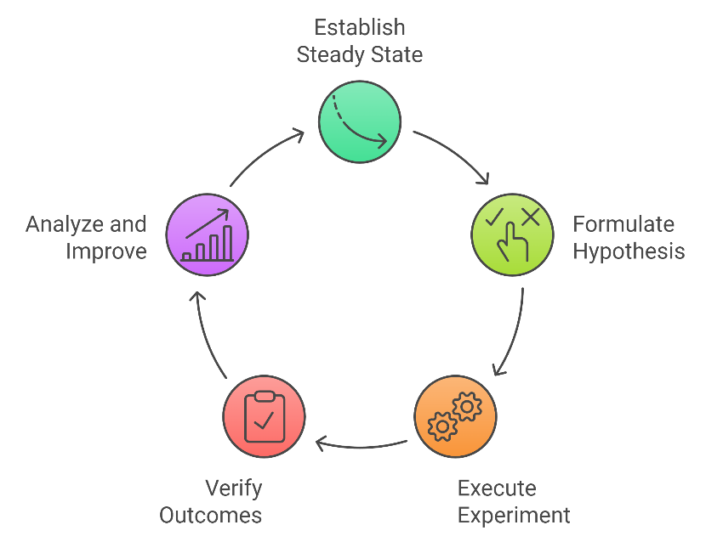
The Chaos Engineering Phases
1
Steady State
Establish normal system behavior as a baseline for comparison.
2
Hypothesis
Define expected deviations and tolerance ranges for system behavior.
3
Run Experiment
Execute controlled, destructive actions to test system resilience.
4
Verify & Analyze
Validate results, analyze unexpected outcomes, and implement improvements.

Slide 18




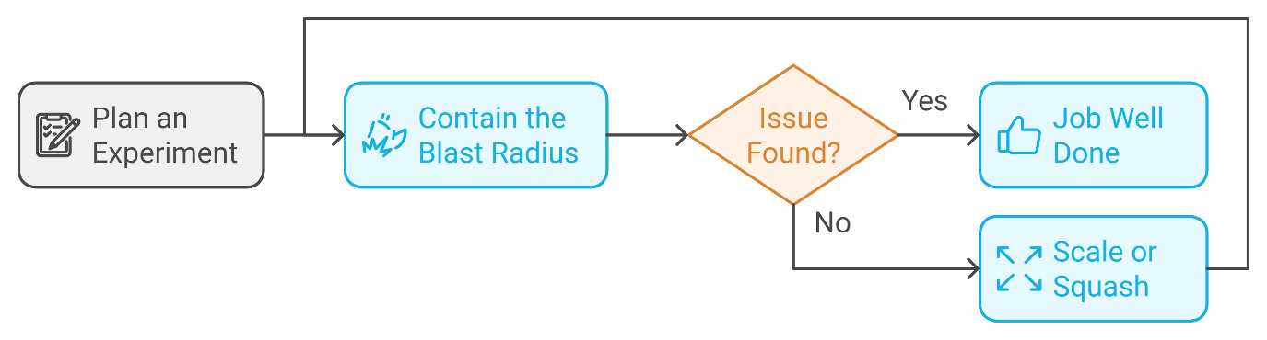
Chaos Engineering: A Strategic Approach
Plan the Experiment
Create hypothesis, identify potential failure points
Contain Blast Radius
Execute smallest test, gain valuable insights
Scale or Squash
Resolve issues or increase scope gradually

Slide 19
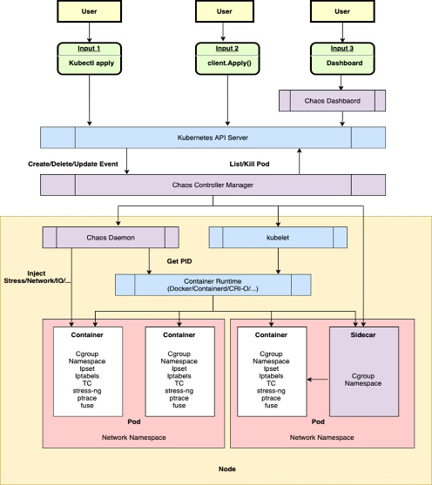
Architecture - Key Components
Chaos Daemon is the core execution engine that runs as a privileged DaemonSet pod on each Kubernetes node in the cluster. It directly interfaces with low-level components including container runtimes (Docker, containerd), the Linux kernel, and iptables to inject various types of faults at the infrastructure level.
The daemon implements specific chaos operations through specialized modules:
- NetworkChaos: Implements TCP packet delays, drops, and corruption using iptables rules
- PodChaos: Forces pod failures, restarts, and kills using container runtime APIs
- StressChaos: Injects CPU/memory pressure using system stress testing tools
- IOChaos: Simulates disk read/write latency using IO control mechanisms
Please note :
When a chaos experiment is initiated through Chaos Mesh CRDs, the daemon receives instructions from the Controller Manager and executes these low-level operations with precise timing and parameter control, while maintaining detailed logs and metrics for experiment analysis.

Slide 20

In Continuation-
Chaos Controller Manager: The central control plane component that manages the lifecycle of chaos experiments. It watches for new chaos custom resources, schedules experiments, and coordinates with Chaos Daemon to execute fault injections. The controller manager ensures proper orchestration and maintains the desired state of chaos experiments across the cluster
Chaos Dashboard: The web-based user interface that provides visualization and management of chaos experiments. It enables users to create, monitor, and analyze chaos engineering tests through an interactive graphical interface, making it easier to track experiment progress and results

Slide 21
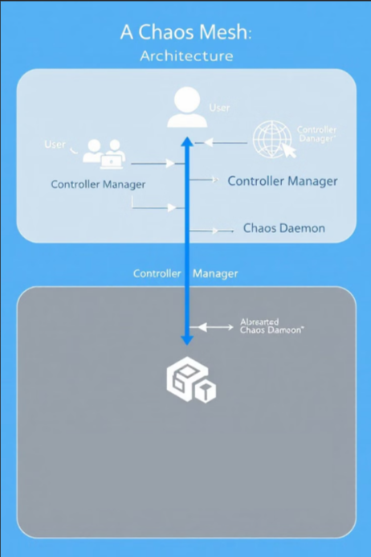



How Chaos Mesh Works: A Three-Step Process
User Interaction
Users define chaos experiments using Kubernetes custom resource definitions (CRDs).
Controller Manager
Watches for CRD changes and schedules experiments to specific Chaos Daemons.
Chaos Daemon Execution
Receives instructions from the Controller Manager and injects failures into target pods or nodes.

Slide 22
Application of Chaos Engineering in end-to-end Payment Process
Why Chaos Engineering?
Ensures resilience in banking payment workflows
Identifies system weaknesses before real failures occur
Improves availability, security, and compliance
🔹 Key Areas of Application
Payment Authorization: Test API failures, latency, and fraud detection
Transaction Processing & Settlement: Validate clearing, reconciliation, and database resilience
Real-Time Payments: Assess load scalability, redundancy, and failover strategies
Regulatory Compliance: Stress-test regulatory audits, SLAs, and security protocols
🔹 Benefits
Minimizes downtime & financial loss
Enhances security & fraud resilience
Strengthens business continuity & disaster recovery
Optimizes customer experience & trust
Addressing the key Vulnerabilities at Infra and Application Level
🚀 Strengthen Your Banking Workflows with Chaos Engineering!

Slide 23
People
Chaos Engineering Mindset
Failures are learning opportunities.
Resilience is built through controlled experimentation.
Teams grow by anticipating and addressing weaknesses.
Key Benefits of Embracing Failure
Proactive Resilience
Learn system weaknesses before real incidents occur.
Innovation Culture
Encourage continuous improvement and experimentation.
Team Empowerment
Foster collaboration across development, ops, and QA teams.
Process
Best Practices
Start small. Limit initial experiments to non-production. Automate testing in CI/CD pipelines. Use blameless postmortems to foster learning.
Structured Process
Define hypothesis. Align scenarios with SLAs. Gradual execution, expand to multi-region chaos. Measure and improve with Grafana.
Governance Framework
Set objectives. Define resilience metrics like uptime. Establish team ownership for experiments. Document learnings in evolving playbook.
Technology & Tools Experimentation Tools
Gremlin: API-level fault injection.
LitmusChaos: Kubernetes-native container failure tests.
AWS FIS: Cloud-native chaos via templates.
Automation in CI/CD
Gremlin APIs/LitmusChaos GitHub Actions.
Terraform Modules for automated chaos.
Observability & Monitoring
Grafana: Visualize system health.
Prometheus & ELK: SLA compliance.
AWS X-Ray: Distributed tracing.
Call to Action
Start Small
Begin with small, controlled chaos experiments.
Psychological Safety
Emphasize safety for teams to explore and innovate.
Key Takeaways
Embrace Failure
See failures as learning opportunities, not setbacks.
Build Resilience
Use controlled experiments to strengthen systems.
Empower Teams
Foster collaboration and innovation through safety.

Slide 24
SIDGS Approach to Chaos Engineering
7 Continuous Learning & Iteration
1 Controlled & Gradual Experimentation
2 Realistic & Business-Critical Failure Scenarios
3 Automated & Continuous Chaos Testing
4 Robust Monitoring & Observability
5 Built-In Failover, Recovery & Self-Healing
6 Security & Compliance Integration
Use case Development & Approval of the client
Controlled & Gradual Experimentation
Realistic & Business-Critical Failure Scenarios
Automated & Continuous Chaos Testing
Robust Monitoring & Observability
Built-In Failover, Recovery & Self-Healing
Security & Compliance Integration
Continuous Learning & Iteration

Slide 25
Implementing Chaos Engineering
1
Use Case Development
2
Business-Critical Scenarios
Develop and approve client use cases.
Focus on realistic failure scenarios.
3
Controlled Experimentation
4
Automated Chaos Testing
Implement gradual chaos tests.
Enable continuous chaos testing.
5
Robust Monitoring
6
Built-In Failover
Improve monitoring and observability.
Ensure failover, recovery, and self-healing.
7
Security Integration
8
Continuous Learning
Integrate security and compliance.
Promote continuous learning and iteration.
VS

Slide 26
Implementing Chaos Engineering
1
Use Case Development
2
Business-Critical Scenarios
Develop and approve client use cases.
Focus on realistic failure scenarios.
3
Controlled Experimentation
4
Automated Chaos Testing
Implement gradual chaos tests.
Enable continuous chaos testing.
5
Robust Monitoring
6
Built-In Failover
Improve monitoring and observability.
Ensure failover, recovery, and self-healing.
7
Security Integration
8
Continuous Learning
Integrate security and compliance.
Promote continuous learning and iteration.
VS

Slide 27
SIDGS Approach to Chaos Engineering
Blast Radius: Testing System Resilience
Identify
Pinpoint crucial systems. Begin testing in non-production setups.
Hypothesize
Predict outcomes. For example, reroute database on node failure.
Experiment
Execute gradually. Start small. Incrementally broaden scope.
Monitor
Measure impact. Use tools like Grafana or Prometheus.
Analyze
Improve resilience. Conduct postmortems. Apply fixes.

Slide 28
Key Pillars of Chaos Engineering
Roles
Responsibilities
Culture
Governance
Experiment
Incident
Tooling
Automation
Scaling Chaos Engineering
People
Process
Operating Model

Slide 29
SIDGS Methodology to Chaos Engineering
Involve the Entire Engineering & Operations Team
Define Clear Objectives & Hypotheses
Start Small & Gradually Increase Complexity
Use Realistic Failure Scenarios
Implement Controlled Experimentation
Monitor & Observe System Behaviour
Automate Chaos Testing in CI/CD Pipelines
Implement Failover & Recovery Mechanisms
Continuous Learning & Iteration
Ensure Security & Compliance in Chaos Experiments

Slide 30
AGENDA
Appendix
Understanding Chaos Engineering
SIDGS Approach to Chaos Engineering
Why Banks Need Chaos Engineering
Chaos Engineering Phases
Common Use Cases Of Chaos Engineering
Fund Transfer End-to-End Flow
End-to-End Workflow Chaos Engineering
SIDGS Methodology to Chaos Engineering
Key Pillars of Chaos Engineering

